Slide 1
Topic: Financial Maths EQ: How Do I Calculate Profit and Loss?
Rule up 3 column notes!
Year 8 Mathematics
Mrs Parlevliet

Slide 2
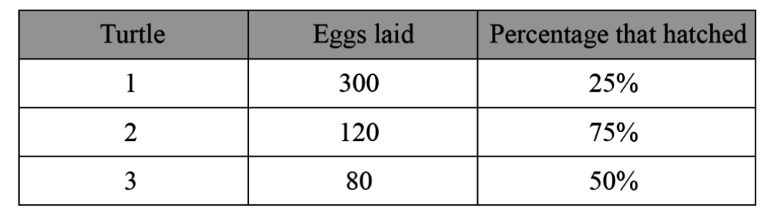
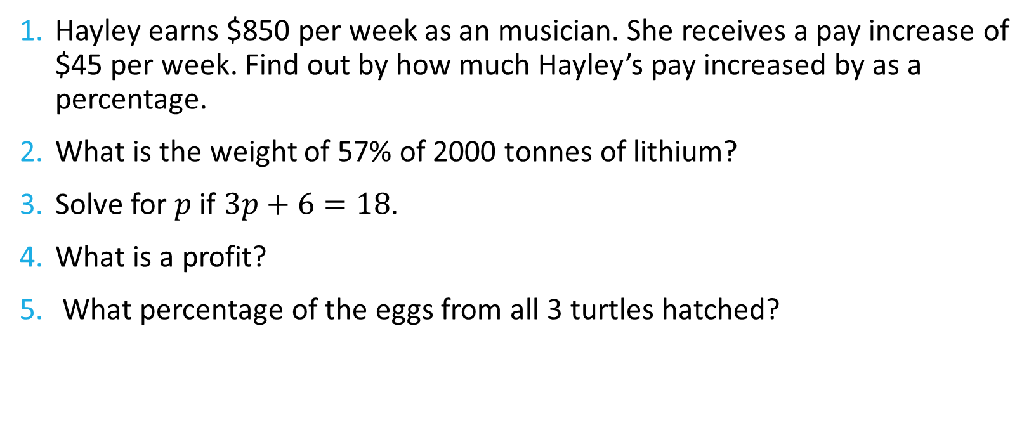
Five Questions (LHS)
Date: XX/XX/2019
Topic: Financial Maths
EQ – How do I calculate a profit and loss?
Hayley earns $850 per week as an musician. She receives a pay increase of $45 per week. Find out by how much Hayley’s pay increased by as a percentage.
What is the weight of 57% of 2000 tonnes of lithium?
Solve for $p$ if $3p+6=18$.
What is a profit?
What percentage of the eggs from all 3 turtles hatched?

Slide 3
24
7
30
Topic: Financial Maths
Date: XX/XX/2019
EQ: How do I calculate profit and loss?
Notes:
If students don’t know where to begin, give them a clue that they need to use Order of Operations to link the numbers on the vertices to the number inside the triangle.

Slide 4
Cost Price
Sale Price
Selling Price
GST
Financial Math
Profit
Loss
Discount
Mark Up
Notes:
Cost price (CP): the total cost of making or buying the goods
Selling price (SP): cost price + mark up
Mark up: amount added to cost price in order to make a profit
Discount: decrease in the selling price to attract more buyers
Sale price = selling price – discount amount
GST: Goods and Services Tax of 10% added to selling price
Profit: difference between SP and CP, where SP > CP
Loss: difference between SP and CP where SP < CP

Slide 5

24
7
30
Topic: Financial Maths
Date: XX/XX/2019
EQ: How do I calculate profit and loss?
What are the profit and loss formulas?
$$Profit as a dollar amount=Sale Price −Cost Price$$
$$Profit as a percentage=\frac{Profit as a dollar amount}{Cost Price}×100$$
$$Loss=Cost Price −Sale Price$$
$$Loss=\frac{Loss in dollar amount}{Cost Price}×100$$

Slide 6
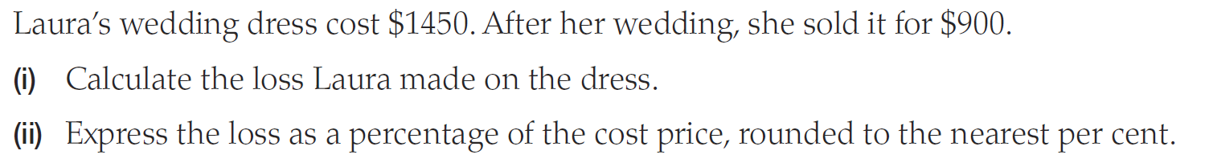
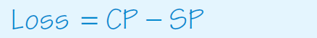
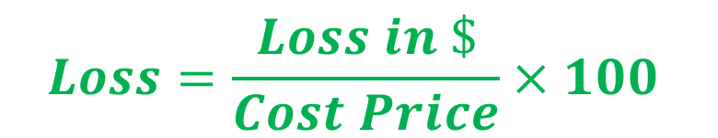
Loss Calculation
$$Loss=\frac{Loss in \$}{Cost Price}×100$$

Slide 7
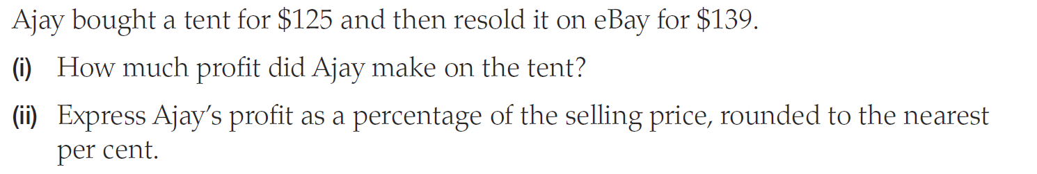
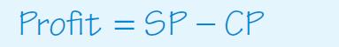

Profit calculation
$$Profit=\frac{profit in \$}{Cost Price}×100$$

Slide 8


Slide 9
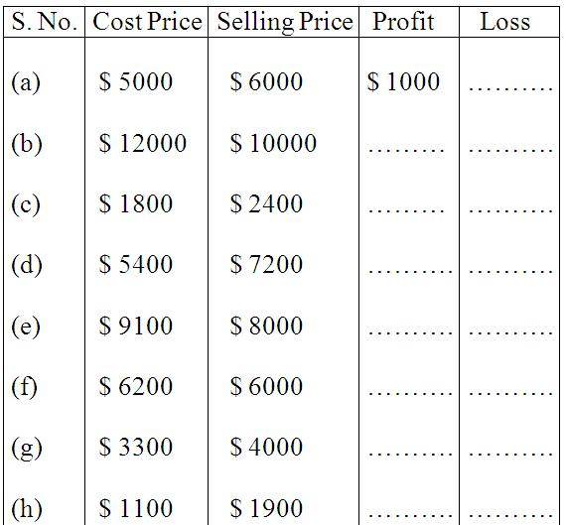
Worksheet
Notes:
a.

Slide 10
A TV was bought for $ 18,950 and sold at a loss of $ 4780. Find the selling price.
A second-hand car was sold for $ 190,000, at a loss of $ 85. Find the CP of the car.
Monica sold her genset for $ 20000 at a profit of $ 1737. Find the CP of genset.

Slide 11
Sam bought a music system for $ 6375.00 and spent $ 75.00 on its transportation He sold it for $ 6400.00. Find his profit or loss percent.
Nick bought pens at $ 120 a dozen. He sold it for $15 each. What is his profit percent?
Radhi bought a study table for $ 9000. She sold it at a profit of 20%. How much profit did she make? What is the selling price?

Slide 12
Find the selling price if the cost price is $ 1200 and loss percent is 25.
Robert bought 20 refills and sold them at $ 4 each. If it had cost $ 50 for the refills, what was his profit or loss percent?
Mr Summers buys pencils at $ 250 per hundred and sells each at $ 1.75. Find his loss or profit.

